Slide 1
The 3 E’s
Using education, employment, and economic development indicators to predict math pisa performance

Slide 2
Agenda
Introduction
Data Cleaning
Feature Selection
Intro to Modeling
Examples of Modeling Graphs
Best Performing Model
Worst Performing Model
Lessons learned and Use Case
Conclusion

Slide 3
Introduction
PISA
Worldwide study to evaluate education systems
Measure education performance of 15 year old students on math, science, and reading
World Development Indicators Used:
Economy - Gross domestic product (GDP), inflation, etc.
Education - Enrollment rates, ratio of teachers to students, vocational versus primary school enrollments
Employment - Wage & salaried workers, unemployment rates based on different criteria

Slide 4
Where does my data come from?
World Development Indicator Dataset from Kaggle: https://www.kaggle.com/worldbank/world-development-indicators
The World Development Indicator Dataset includes over a thousand annual indicators for roughly 247 countries. The dataset has information for 55 years (1960 to 2015).
PISA data: https://pisadataexplorer.oecd.org/ide/idepisa/
The PISA data website allows us to select from 100s of countries. It measures the performance of 15 year old students in the subjects of math, science, and reading. The data used in my project brings in the PISA scores from 2003 to 2015

Slide 5
Data cleaning
Decision was made to focus on one PISA area (math) as opposed to all three due to collinearity
Columns that were not relevant from merged datasets were dropped
Replaced null values with PISA averages for countries
Merged data sets
Removed years that did not exist in PISA
Aggregating and formatting data in correct shape to ensure wide format

Slide 6
Feature selection
The 2 datasets are quite large and contains a lot of collinearity
We started with thousands of development indicators, but through data cleaning, have been able to narrow down to 28 features (indicators)
Usage of cluster and heat maps provide visuals of highly correlated features
Helpful in determining if features might be repetitive of each other
First look at what features related to each other and starts to show trends

Slide 7
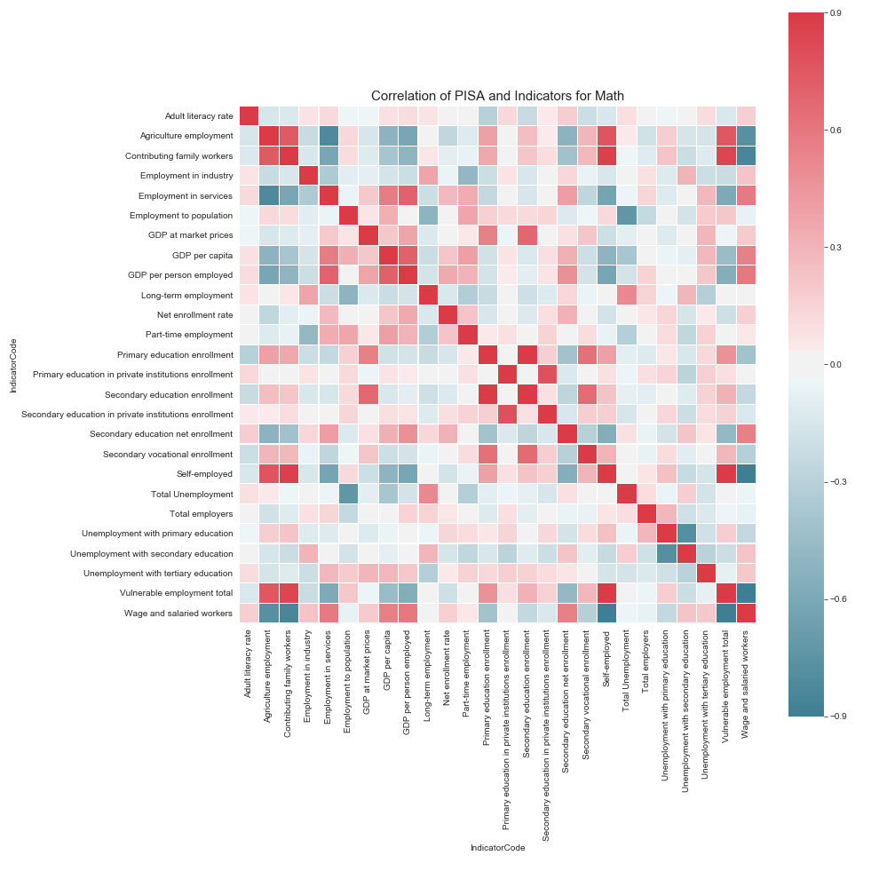
Feature selection
Heat Map
Allows visual of features and if collinearity exists
Able to revisit data and clean up further to reduce collinearity
Shows areas of high vs low correlation

Slide 8
Intro to modeling
Y is PISA Score (continuous on scale of X to X – find it and put it in there – have that weird graph from old version I can show)
X is 3 E’s World Indicators
Scores are measured by R^2
Types of models used for the 3 E’s
Random Forest Regression
Linear Regression
Lasso Regression
Ridge Regression
Gradient Boost Regression
K Nearest Neighbors Regression

Slide 9
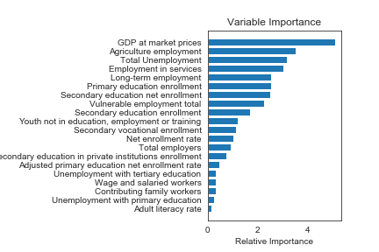
Examples of modeling graphs
Gradient Boost
Measure importance of variance features by counting how many times a features is used over the course of many decision trees
Model shows the employment features are at the top

Slide 10
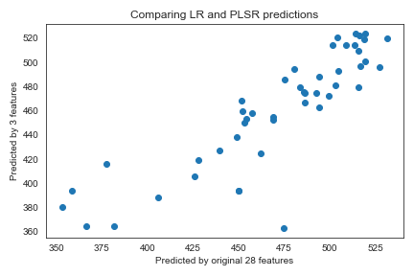
Examples of modeling graphs
Linear Regression Comparison to Partial Least Squares Regression
Comparison of performance of original 28 features against reduction to 3 features
Looking at the model, the accuracy is not the best, but data is not suffering from overfitting

Slide 11
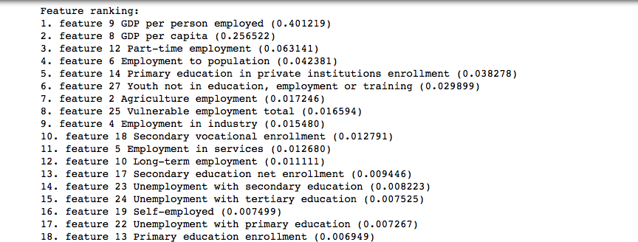
Best performer – random forest
Ranking of features consistent with what we have seen in other models
Delta between training and testing data is not high
Overfitting has been corrected

Slide 12
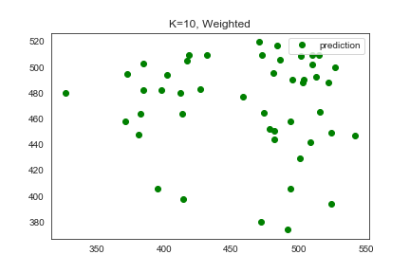
Worst performer – K nearest neighbors
Working with features that are different from each other
Attempt to predict math PISA score against development indicator
There are no neighbors because of this
Model does not return good data

Slide 13
Lessons learned and use case
Lessons Learned
Use Case
When modeling, reduce collinearity.
Reduce features - should not have more features than rows
Eliminate redundant features
Use of correlation plots to provide a visual of features that are duplicates and should be removed
Establish specific timeframe you want the data to pull from to provide more accurate averages
App geared towards expats
Analysis to aid countries on economic spend versus investment in different areas for growth – focus on PISA. If country was looking to improve PISA, etc – edit this blurb

Slide 14
Conclusion – same as intro, make more bullet point and then talk to it
More data does not equal accurate models
Leads to overfitting due to collinearity
Inconsistent trends
Significant deltas between testing and training data sets
What surprised me about the features?
Economy and Employment indicators ranked higher in predicting higher math PISA scores than Education
Models such as ridge, showed results that certain indicators actually result in lower PISA scores that were not expected
Higher self employment shows lower PISA scores

Slide 15
Thank you

